Slide 1
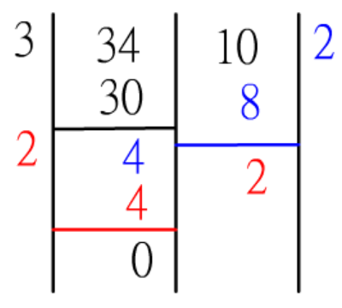
Project : Euclidean algorithm
Using Euclidean algorithm to find the greatest common factor.
Using MIPS to complete this project.
Please do it yourself and do not copy others work.

Slide 2
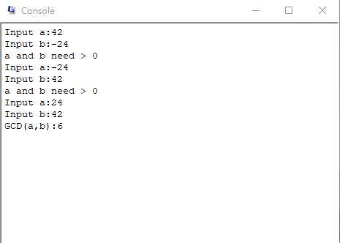
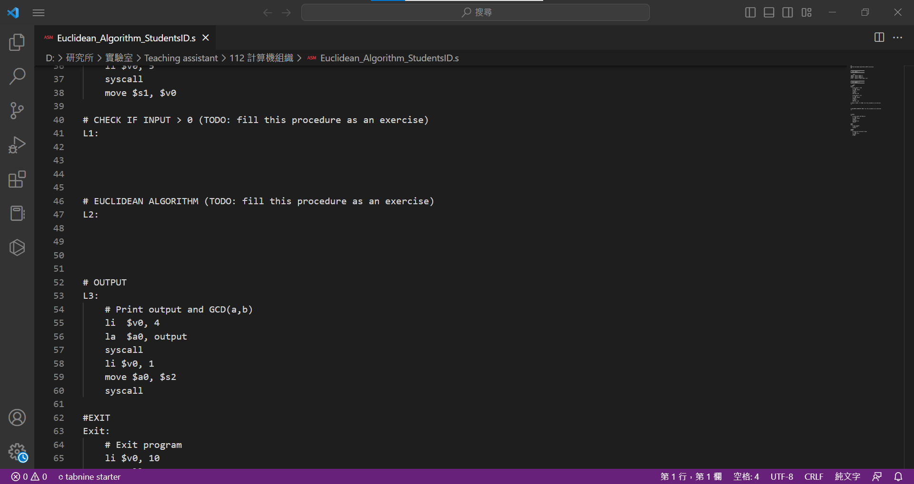
Project : Euclidean algorithm
your code
your code

